Slide 1
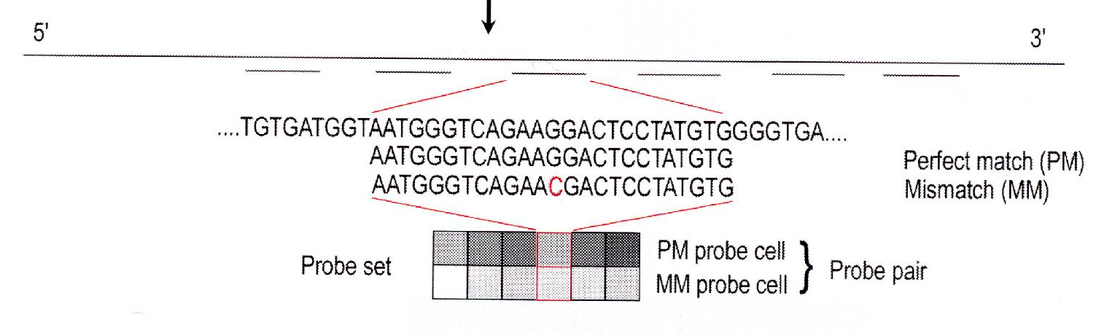
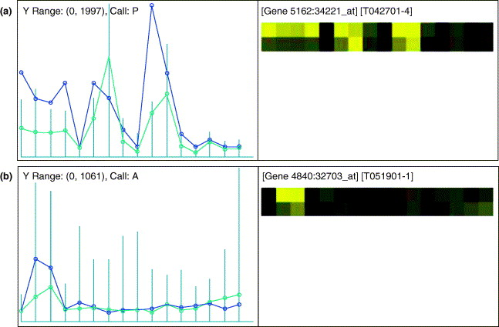
Study design: what is expected of microarrays?
Draghici et al. (2006)
Notes:
When to apply microarrays:
Get a number = intensity of the hybridization of the probe with the target :. Higher signal = more binding and higher concentration of the RNA you are looking at
When comparing between samples: assumptions: samples of equal quality and quantity of RNA at baseline
When comparing between genes, probes hybridization rates can skew results, for this reason, probes are picked that aren’t performing horribly well or badly relative to each other
For any one gene, there is typically a 16 fold difference between the lowest intensity per probe and the highest
:. We are NOT TECHNICALLY MEASURING GENE EXPRESSION

Slide 2
Genomic Study Design
Yoav Gilad
Human Genetics department
CLSC room 325C
Phone: 773-702-8507
Email: gilad@uchicago.edu

Slide 3
Study design: what is expected of microarrays?
Different probes meant to represent the same transcript can yield widely different signals. The left panels show the perfect match (PM, in blue) and mismatch (MM, in green) values across the probes in the same probe set.
Draghici et al. (2006)

Slide 4
Study design: what is expected of microarrays?
Measuring vs. comparing gene expression:
Accurate concentration measurements will also provide accurate measurements of expression ratios but the reverse is not true.
Notes:
**********
Always assume that there is a background signal
Ex
I = (signal of probe)(# of probes hybridized) + Background

Slide 5
Study design: what is expected of microarrays?
Ratios can be measured with greater accuracy than concentrations.
What about the detection of gene expression?
Notes:
We can detect gene expression, but only if it is above the threshold of the negative control

Slide 6
Study design: what is expected of sequencing?
What is expected from RNA sequencing studies?
Can we use RNAseq to detect gene expression?
Can we use RNAseq to measure absolute expression levels?
Obvious differences between RNAseq and microarray experiments include….
Yes
No-ish,
Can compare expression between samples, assuming the same quality of RNA
Notes:
Different genes have a different likelihood of getting sequenced

Slide 7
Study design: inherent variability in genomic data
The experiment:
Extract a sample of RNA or DNA from each specimen and through laboratory and measurement routines obtain an estimate of the ratio C_{gn}/C_{gn′} of each gene in a designated gene set G_{a}
What is the biological / technical variance that will affect our experiment?
1st
2nd
Notes:
More highly expressed = in actually, it has a higher ratio compared to the expression of the same gene
Ex. 5x GAPDH vs. 15x GAPDH

Slide 8
Study design: inherent variability in genomic data
A comparison of gene expression patterns between treated and untreated cell lines
Is it enough to study the difference in gene expression between one treated and one untreated cell?
What is a biological specimen in this case?
Notes:
Same cell # per condition
Pick a moderately high number to get the lowest variability feasible with financial and time constraints
When to sync cell cycle:
increase power by reducing variability from cell to cell that is due to differences in when they are in different phases
Danger: added a processing step in a VERY sensitive system
KEEP PROCESSING STEPS LOW WHEN POSSIBLE

Slide 9
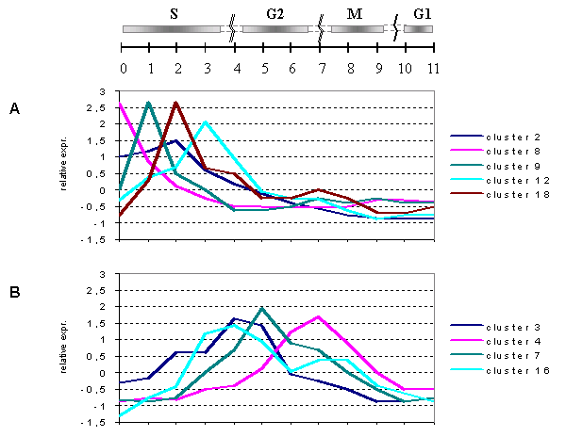
Study design: inherent variability in genomic data
Gene expression in changes during cell cycle.
Breyne et al. (2002)

Slide 10
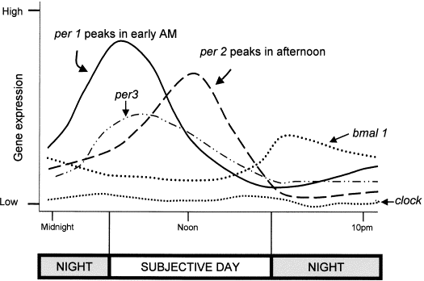
Study design: inherent variability in genomic data
Mammalian circadian gene expression in 12 hour light/12 hour dark cycle.
Bunney et al. (2000)
Notes:
To drop circadian variability, take samples at the same time every day

Slide 11
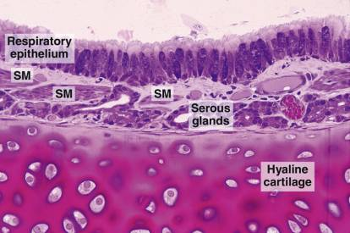
Study design: inherent variability in genomic data
A comparison of gene expression patterns between a normal lung tissues and a diseased lung.
Is it enough to study the difference in gene expression between one tumor and one healthy lung?
Notes:
What is the biological sample?:
Controls:
Make sure they are representative for their category, example: healthy, ill
Size of the punch, number of punches, location of punches, depth of punches
From each patient
Technical/biological = sample of three from each tissue of interest per patient

Slide 12
Study design: inherent variability in genomic data
A comparison of gene expression patterns between a normal lung tissues and a diseased lung.
Is it enough to study the difference in gene expression between one tumor and one healthy lung?
What is a biological specimen in this case?
Is there more than one tumor per host?
What is the developmental stage of the tumor?
How many tumor-host combinations?
Matching case-control samples?

Slide 13
Study design: inherent variability in genomic data
A comparison of gene expression patterns between treated and untreated cell lines
5 treated wells
5 untreated wells
All harvested at the same time
Sample processing introduces technical variance:
Notes:
Start:
Plate cells, split into 10, then introduce treatments
Harvest at the same time, that way we don’t worry about time as a variable
Process some of the treated and untreated all at the same time, do repeatedly til you hit your required N
IF YOU MUST HAVE VARIABILITY, PICK A PROCESSING STEP THAT IS EXPECTED TO PRODUCE THE LEAST VARIABILITY

Slide 14
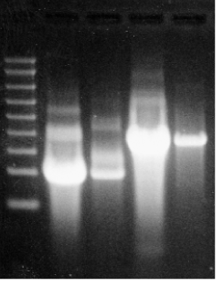
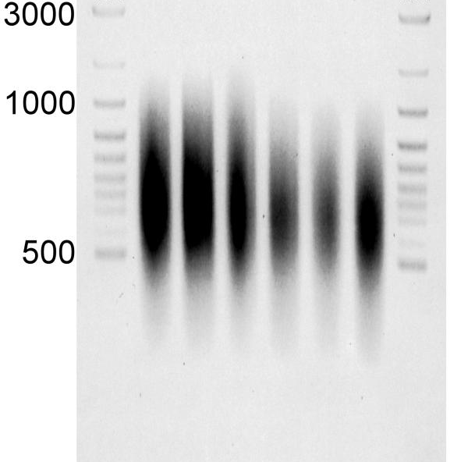
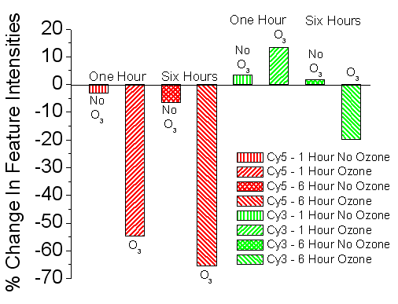
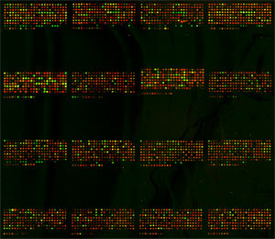
Study design: inherent variability in genomic data
Total RNA
Preparation of mRNA
RT and amplification of RNA
Fluorescence labeling
Hybridization reaction
Scanning and image processing
Dye effect
Amplified RNA
Notes:
HOW TO ACCOUNT FOR HUMAN INABILITY TO DEAL WITH HAVING SO MANY SAMPLES AT ONCE:
Ex. pooling
“can eliminate technical steps if they are balanced by biological sample treatment”
Ex. don’t put all of your control samples in the same lane
Ex. don’t put all of your experimental in the same lane
“property of the study” = how many flow cells you need , how many arrays, how many bottles of a drug you need
When to replicate = when you can’t increase the power, through technical means. And the inherent variability of the process is expected to be high relative to the amount of signal you would get purely due to the treatment.
Every time you don’t know if you have to replicate, and don’t know the effect of the variable on your study,
THEN YOU HAVE TO DO A PILOT STUDY,

Slide 15
Study design: inherent variability in genomic data
A comparison of gene expression patterns between treated and untreated cell lines
5 treated wells
5 untreated wells
All harvested at the same time
2 RNA preparation replicates
2 labeling replicates (or a dye swap)
2 hybridization replicates
2 scans of each hybridization
What about the arrays or flow cells?

Slide 16
Study design: inherent variability in genomic data
Array batch / flow cell
Instrument
Sample processing…

Slide 17
Study design: inherent variability in genomic data
A comparison of gene expression patterns between treated and untreated cell lines
5 treated wells
5 untreated wells
All harvested at the same time
2 RNA preparation replicates
2 labeling replicates (or a dye swap) / library preps
2 hybridization replicates / clustering
2 scans of each hybridization / sequencing lanes
X 2 arrays / flow cells

Slide 18
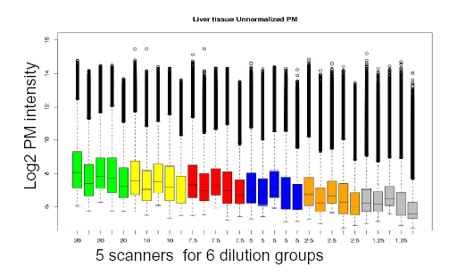
Study design: inherent variability in genomic data
What about the sequencer / scanner effect?

Slide 19
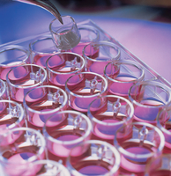
Study design: experimental design
Can we avoid replication by pooling samples?
For example: Instead of performing 5 different hybridizations, can we pool RNA from 5 replicates of treated cells and hybridize them together?
Notes:
Randomize or balance variables that introduce bias
Pooling take more than 1 sample, and mix them all together

Slide 20
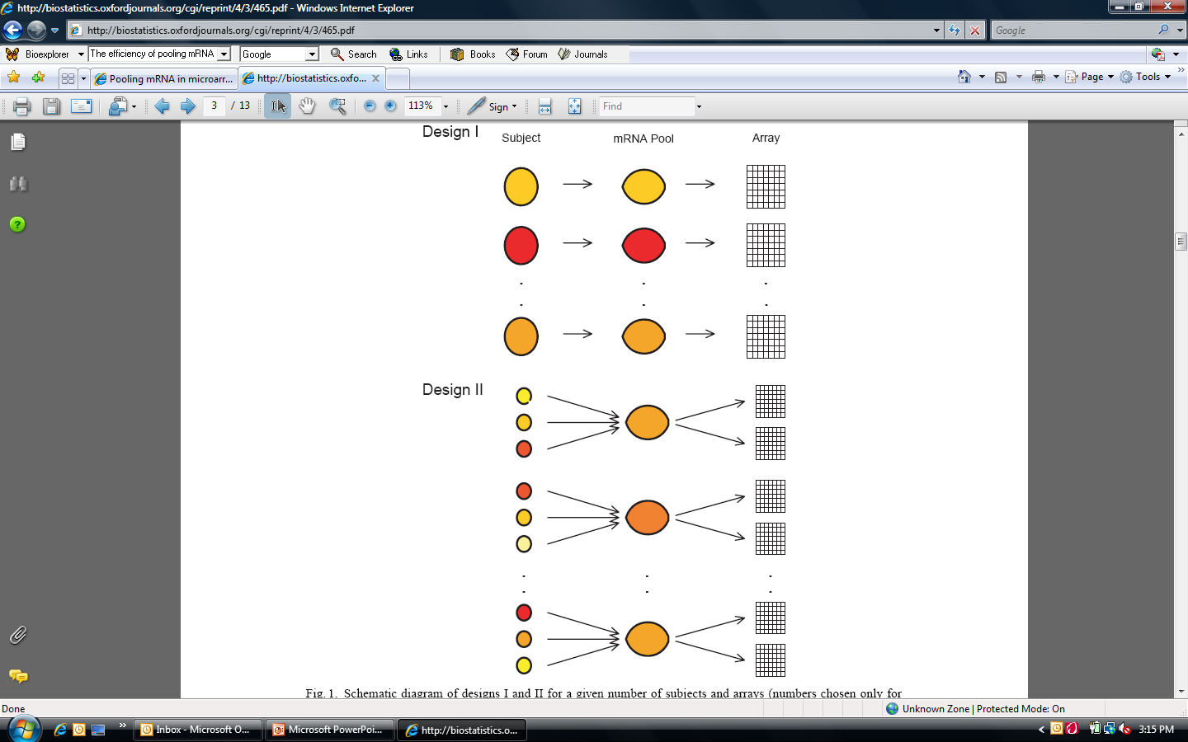
Study design: experimental design (pooling)
Number of individuals per pool
Ns = 3
Number of technical replicates per pool
Na = 2
Kendziorski et al., (2003)
Notes:
why are there two microarrays per pooled sample
Goal in pooling: minimize the number of microarrays used
Goal: do this while keeping the same power
Variance in pooled samples = technical (less) + average expression between # of pooled samples
Variance in non-pooled samples = technical (more) + variance between individuals
With pooling, we lose the power b/c on the statistical test, we have a reduced number of INDEPENT SAMPLES
Non-pooling strategy- helps you give more accurate estimates of technical variance :. When we are expecting high technical variance then we want to use this strategy

Slide 21
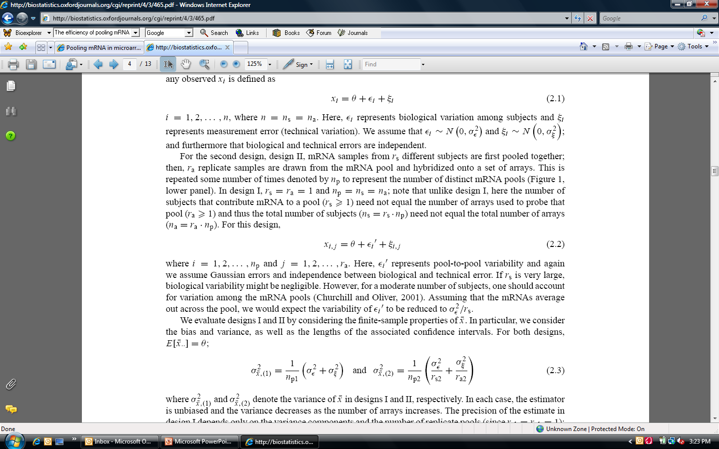
Study design: experimental design (pooling)
Design 1:
Biological variance
Technical variance
Gene expression
Measurement
i = 1, 2, . . . , n, where n = ns = na
(for design 1).
Kendziorski et al., (2003)

Slide 22
Study design: experimental design (pooling)
Design 1:
Design 2:
i = 1, 2, . . . , Np and j = 1, 2, . . . , Na
Number of pools
Kendziorski et al., (2003)

Slide 23
Study design: experimental design (pooling)
Variance of the measurement in designs I and II
The precision of the estimate in design I depends only on the variance components and the number of replicates (since Ns1 = Na1 = 1); for design II the precision also depends on the number of mRNA samples that are pooled and the number of arrays used to probe a given pool.
Kendziorski et al., (2003)
Notes:
In order for pooling to be worthwhile,
we want equal precision, and we will have to have certain number of pools to compensate (cant just combine everything)
Study design 1:
1/15 (1+4) = 1/3
Study design 2:
1/

Slide 24
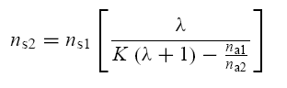
Study design: experimental design (pooling)
It can be shown that the precision of the two designs is similar when:
The ratio of biological to technical variance
Kendziorski et al., (2003)
Notes:
Lamba = ratio between biological: technical variance
Lambda is high = when biological variance is high compared to technical variance
When lambda is high, then you want to pool

Slide 25
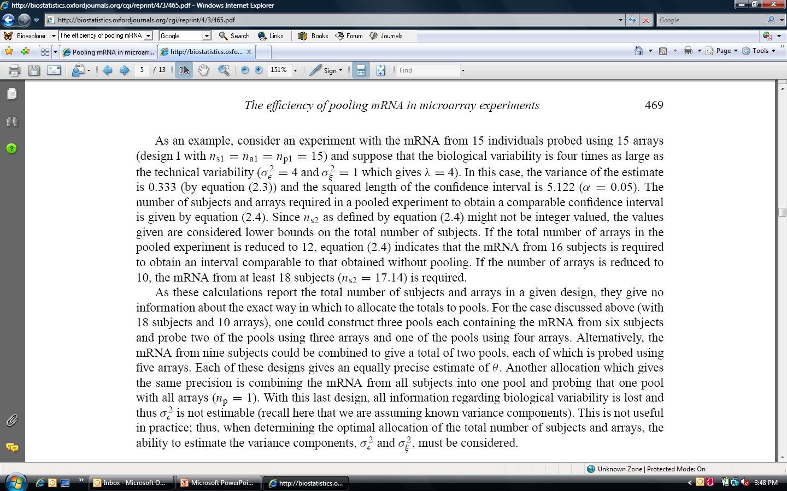
Study design: experimental design (pooling)
17.14 = 15 [ 4 / (5 – 1.5)]
Reflects 33% fewer arrays
Kendziorski et al., (2003)

Slide 26
Study design: experimental design (pooling)
Design I: 50 arrays (50 individuals)
Design II | 40 arrays | 25 arrays
λ = 1.2 | 64 individual | 300 individuals
λ = 2 | 58 individuals | 100 individuals
λ = 4 | 54 individuals | 66 individuals
Kendziorski et al., (2003)

Slide 27
Study design: experimental design (pooling)
Design II: 50 individuals 50 arrays.
Which design is better?
Each of 25 pools of 2 individuals hybridized in 2 technical replicates
Each of 10 pools of 5 individuals hybridized in 5 technical replicates

Slide 28
Study design: experimental design (pooling)
Warning: Do not pool small number of samples!
Jolly et al., (2004) Physiol. Genomics
Kendziorski et al., (2005) PNAS

Slide 29
Study design: experimental design
Given limited resources (money, arrays, biological material), how do we choose which experimental levels to replicate?

Slide 30
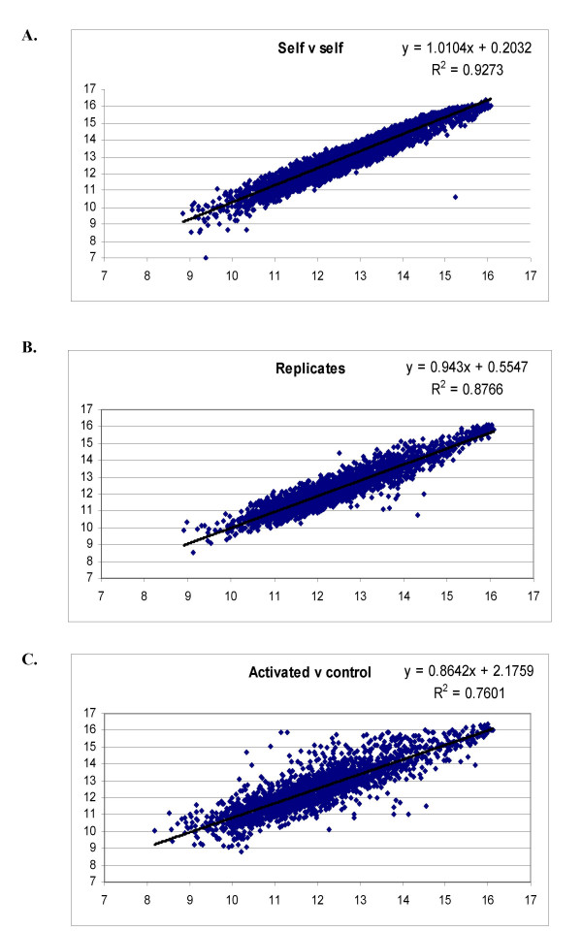
Study design: experimental design
Given limited resources (money, arrays, biological material), how do we choose which experimental levels to replicate?
Smith et al. BMC Genomics 2006

Slide 31
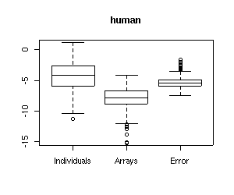
Study design: experimental design
Given limited resources (money, arrays, biological material), how do we choose which experimental levels to replicate?
Gilad et al. 2006

Slide 32
Study design: experimental design
If equal number of samples are assigned to each treatment, then the design is called balanced
 | Wild type | Mutant
RNA prep 1 | Sample 1 | Sample 1
RNA prep 2 | Sample 1 | Sample 1
RNA prep 1 | Sample 2 | Sample 2
RNA prep 2 | Sample 2 | Sample 2
Samples in blue are hybridized on Monday; Red are hybridized on Wednesday

Slide 33
Study design: experimental design
If equal number of samples are assigned to each treatment, then the design is called balanced
Using a balanced design with respect to an effect that is not of interest prevents a bias.
 | Wild type | Mutant
RNA prep 1 | Sample 1 | Sample 1
RNA prep 2 | Sample 1 | Sample 1
RNA prep 1 | Sample 2 | Sample 2
RNA prep 2 | Sample 2 | Sample 2
Samples in blue are hybridized on Monday; Red are hybridized on Wednesday

Slide 34
Study design: experimental design
If equal number of samples are assigned to each treatment, then the design is called balanced
Using a balanced design with respect to an effect that is not of interest prevents a bias. We are not interested in estimating these effects and hence we chose a design where these sources of variation are confounded with the main effect.
As a result, the unexplained variance is increased and the power to detect differences between the main effects decreases (yet, there is no bias in the estimates of the effects).

Slide 35
Study design: power analysis
How many replicates do we need to - - - do what?
= The size of the difference in expression between two classes we wish to be able to detect
We plan to use a single-label array
We assume that expression measurements are approximately normally distributed within the same class
s = The standard deviation of expression level for a gene, among samples within the same class

Slide 36
Study design: power analysis
False positive rate: α
False negative rate: β
The significance level (α) is the probability of concluding the gene is differentially expressed between the two classes when in fact the means are the same (i.e., δ = 0)
Statistical power (1-β) is the probability of rejecting the null hypothesis that genes are not differentially expressed when the true difference in the mean expression levels between the two classes is δ.

Slide 37
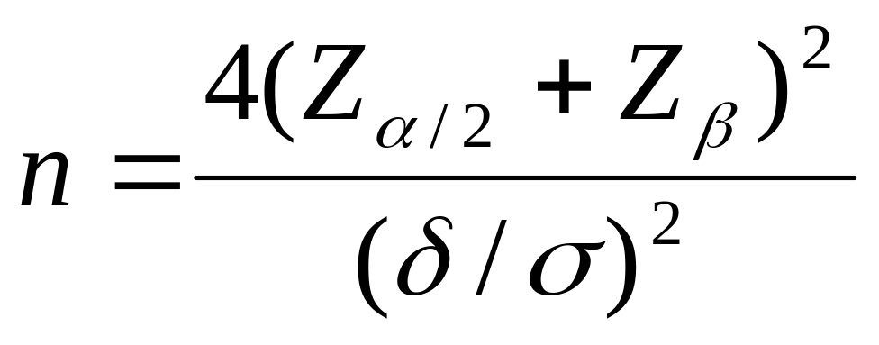
Study design: power analysis
Z_{α/2} and Z_{β} denote the corresponding percentiles of the standard normal distribution
Simon et al. (2002)

Slide 38
Study design: power analysis
= 0.001 → Ζ_{α/2} = −3.29
= 0.05 → Ζ_{β} = −1.645
δ | σ | n
1 (twofold) | 0.5 | 24
1 (twofold) | 0.2 | 4
0.6 (1.5 fold) | 0.2 | 16
Simon et al. (2002)

Slide 39
Study Design: references
M. K. Kerr and G. A. Churchill. Experimental design for gene expression microarrays. Biostatistics (2001) 2:183-201
M. K. Kerr Design considerations for efficient and effective microarray studies. Biometrics (2003) 59(4):822-8
J. Fu and R. C. Jansen. Optimal Design and Analysis of Genetic Studies on Gene Expression. Genetics (2006) 172: 1993-1999

